Slide 1
Human Factors
Stage 3 – A user storyboard for
Smart Meter Confusion Webpage
Artefact 3.3

Slide 2

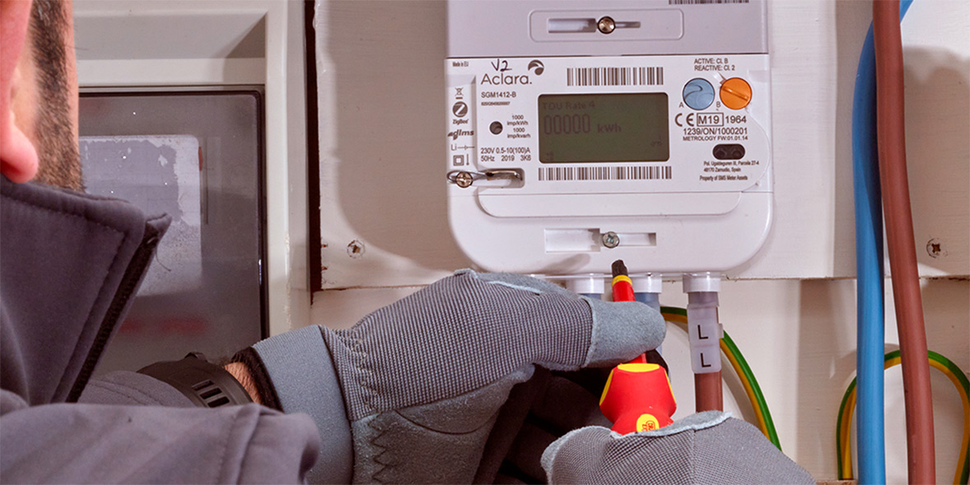
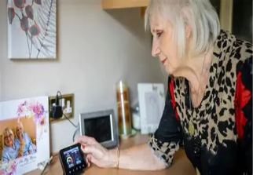


First User Interaction
The engineer has just left after installing a smart meter with no explanation how they work. Advised to contact supplier for any issues
Symbolises the smart meters technical process, which the user does not understand
High cognitive load occurs due to limited guidance and unclear feedback.

Slide 3


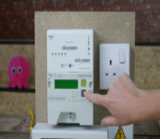

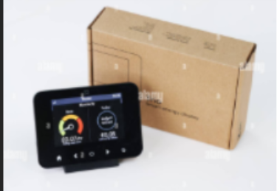


User Attempts to Interact
The customer is unsure where to begin. They press buttons repeatedly but get nowhere.

Slide 4



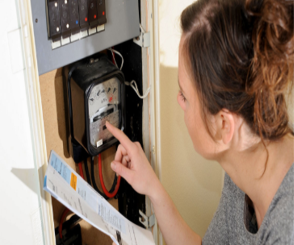
Trial and Error
User tries different methods to understand. Attempts include following instructions, asking a neighbour, and searching for a contact number showing trial and error and increasing cognitive load.​

Slide 5






Seeks Help / Guidance
User transitions from trial‑and‑error to seeking structured help. This reflects a shift from independent problem‑solving to guided support, reducing cognitive load and improving task success
However …......

Slide 6
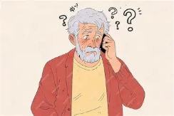

Overloaded by Technical Jargon
It loooks like a DCC connectivity fault
The customer was overloaded with technical language and concepts they did not understand over the phone leaving the call still none the wiser.
The HAN signal isnt pairing correctly with the WAN gateway
Your meter is in asynchronous diagnostic mode
This confusion inspired the Smart Meter confusion webpage.

Slide 7



Resolving the Confusion.
Turning jargon into clarity through a human centred approach.
The Smart Meter Confusion webpage. Clear language and easy to navigate user trust is gained, confusion is resolved and overall satisfaction.

